Slide 1

Population strategist
Tapping potential of population with arabinda chand

Slide 2
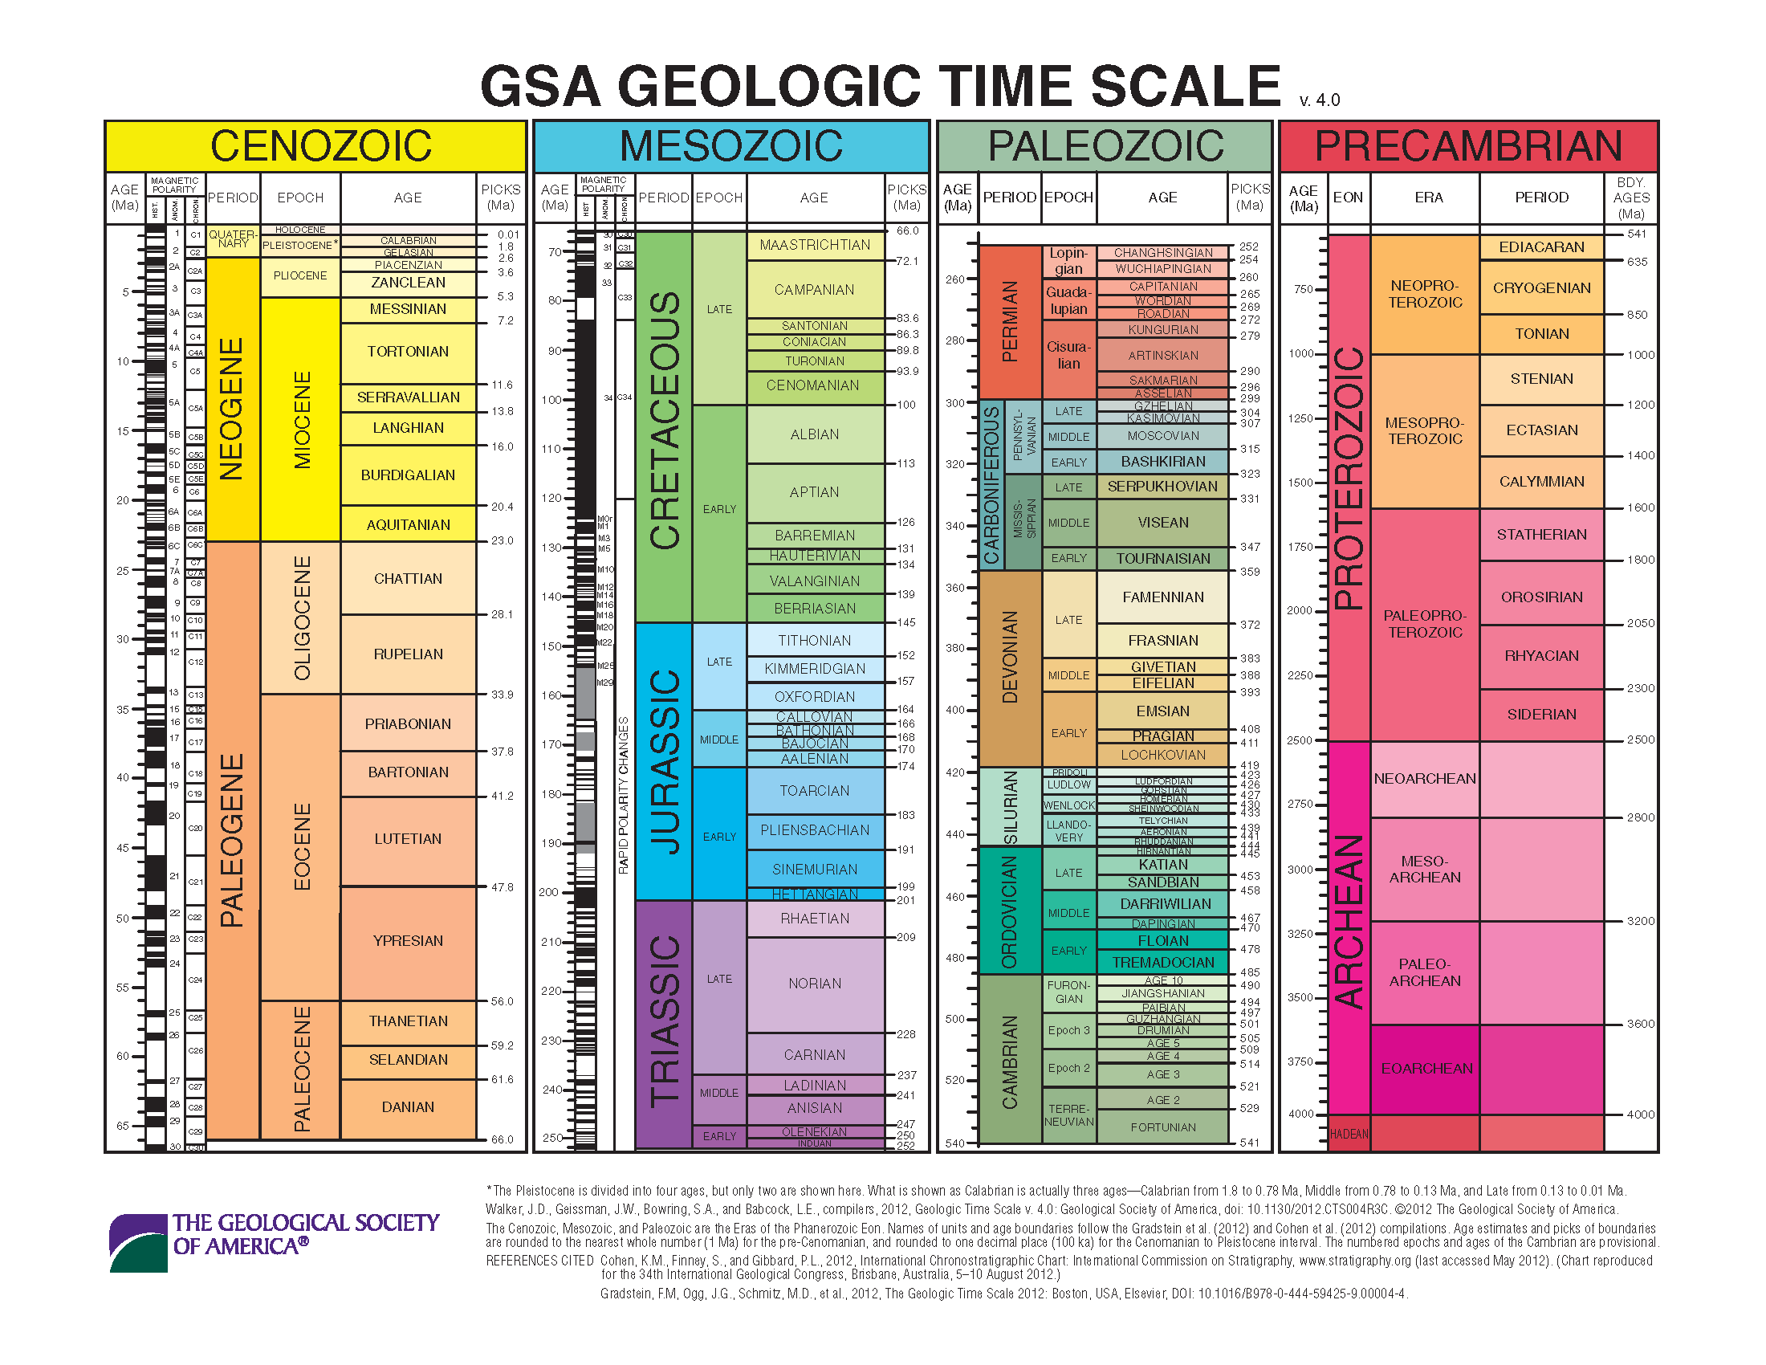
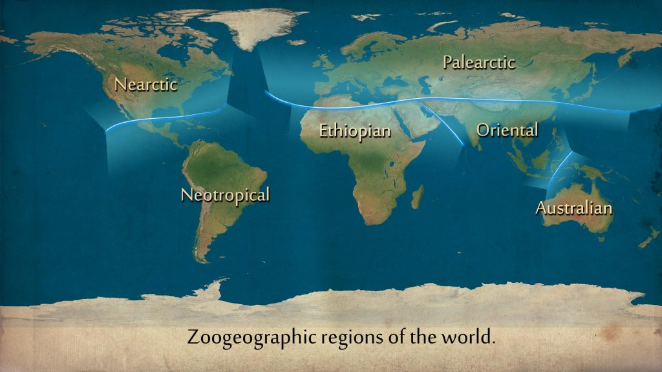
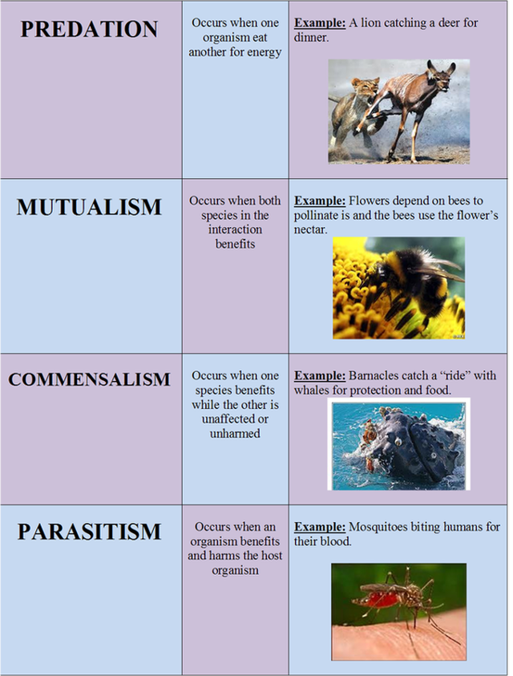

intro
Ecology-relationship between organism & environment,adapt adjust
Level of ecology-individual(one),population(one species),community(many species), ecosystem(one type of environment with species), landscape(one bound region),biome(one climatic&vegetative zone),biosphere(one inhabitable planet)
Weather vs climate=sudden change/stay longer(if local called microclimate)
Habitat vs niche(microhabitat)-where someone lives vs functionality of place
Biome-tundra(permafrost),temperate(lil snow),deciduous(moderate winter),tropical(rainforest(hot n humid) n deciduous(lil wet )),broadlaeaf scrub forest,grassland,desert(plain with grass),alpine tundra(snow mountain )
Ecology started in 1869 by Hanns Helter,Ernst heckel & eduard suess,its fauna and flora and non living stuff in environment
Humans classify based on similarity&differences to distinguish,identify&catalogue
Reproduction make life,variation,species continue &manage population balance.
This Photo by Unknown Author is licensed under CC BY-SA-NC

Slide 3
Dive into ecology
Geological time-scale by stratigraphical data-Cenozoic(Pleistocene,Pliocene,Miocene,Oligocene,Eocene, Palaeocene,Mesozoic(Cretaceous,JurassicTriassic),Palaezoic(Permian,Carboniferous,Devonian,Silurian, Ordovician,Cambrian),Proterozoic,Archaezoic(Precambrian)
Biogeography-distribution of evolution,regions;Palaearctic(old world),Nearctic(North America),Ethiopian(Africa) Oriental(Asia),Neotropical(south&central America),Australian
Organisms compete for food,territory&mate,run from climate,predator&disease carry caoacity by space limits population from log graph to sigmoid graph or starve resulting in isolation,natural(survival of best) depends on environment by variability(chromosome(deletion,duplication,inversion,translocation,aneu&poly ploidy),gene(substitution,add,recombina&deletion),mutation rates).sexual(some gender strong but they’re also most visible compensates advantage),kin(group) selection by altruism(group act benefit each other)
Species extinction-narrow geography,small or declining population due to hunting,large species,niche specific, bad dispersers,less gene variation,seasonal migrants,unspoilt no contact habitat,related to extinct,aggregators.reason-pollution,habitat loss,exploitation,disease,food loss,invasion,termination,climate change,calamities,ecosystem imbalance,extinction’s rarely positive but give minority chance to grow,wide population extinct if stress unbearable

Slide 4
Delve deep on population
Epidemiology’s studying disease distribution&determinant applied to prevent disease,study design-observational (descriptive(case report&series),analytic(Ecological,cohort,case-control,cross-section)),experimental (randomized(clinical,field&community trials),non-random(uncontrolled,natural,(noncontrol,pre&post,crossover interventional)trials)
Ecology is study of habitat in Greek as linked to food,clothing&shelter,autecology-individual relation with environment,synecology-population&community ecology(relate to environment)),component;biotic(living-autotroph plant(self food),hetrptroph animal(depend other food),Saprophytic decomposer(eat dead))&abiotic(nonliving-climatic-temperature,light,edaphic-soil type&property,physical factor-air&water,material-minerals),natural vs artificial,micro vs macro & aquatic vs terrestrial ecosystem & population’s group of same species in an area at a time
Dn/dt=rn,b-d=r(exponential),dn/dt=rn*(k-n)/k(logistic) population growth,composition&distribution demographic (people in area) equations
population grow india-advance agriculture,disease control,education spread,calamity protect,govt effort,better transport&storage,population control-education,marriage age,incentives,family planning,population problem-poverty,food reduce,unhygiene,shelter issue,unemployment,pollution,education shortage
Birth control-temporary(natural(periodic absence,coitus interruptus,lactation amenorrhea),barriers(c**doms,diaphragm,cervical caps&vaults),sp**mic*des,IUT’s,oral(mini&combined pills),subcutaneous norplants,Depoprovera hormones,emergency morning pills),permanent(tube&vasectomy)&medical termination(law applies)
Birth problem-infertility-primary(never conceive),secondary(conceived but now cant),male-cryptochord(t*stes not in scrotum),alcohol(less spermatogen),thyroid dysfunction,impotency(cant ere*t),less gonadotropin(LH,FSH),antihhypertensive&psychotic drugs,immotile cilia(no movement),ychromosome delete,blocked&cut vas,infection(mumps,seminal vesicle&prostrate,coital issues,low fructose,antisp*rm antibody(IgG,IgM,IgA),varicocele(dilated vein heat scrotum),less androgen,female-anovulation(no corpus luteum),ut*rus&v*gina growth defect,luteal phase defect(drug reduce FSH&LH),chronic endomeritis,fibroid uterus(unfavourable),fimbriae cant move,chronic cervicitis(ineffective sp**m),dyspareunia(pain),macrophage(phagocytosis),fertilize fail,miscarriage,ectopic pregnancy,tube cut
Treatment-testtube baby,artificial ins*mination,gamete intrafallopian transfer,ontracytoplasm sp*rm inject,surrogacy

Slide 5
Why I chose R programming?
There are many things R can do for data scientists and analysts. These key features are what set R apart from the crowd of statistical languages:
1. Open-source
R is an open-source software environment. It is free of cost and can be adjusted and adapted according to the user’s and the project’s requirements.
You can make improvements and add packages for additional functionalities.
R is freely available. You can learn how to install R, Download and start practicing it.
2. Strong Graphical Capabilities
R can produce static graphics with production quality visualizations and has extended libraries providing interactive graphic capabilities.
This makes data visualization and data representation very easy.
From concise charts to elaborate and interactive flow diagrams, all are well within R’s repertoire. Look at the attractive graphical visualizations in R.
3. Highly Active Community
R has an open-source library which is supported by its growing number of users.
The R environment is continuously growing. This growth is due to its large user-base.
4. A Wide Selection of Packages
CRAN or Comprehensive R Archive Network houses more than 10,000 different packages and extensions that help solve all sorts of problems in data science.
High-quality interactive graphics, web application development, quantitative analysis or machine learning procedures, there is a package for every scenario available.
R contains a sea of packages for all the forms of disciplines like astronomy, biology, etc. While R was originally used for academic purposes, it is now being used in industries as well.
5. Comprehensive Environment
R has a very comprehensive development environment meaning it helps in statistical computing as well as software development.
R is an object-oriented programming language. It also has a robust package called Rshiny which can be used to produce full-fledged web apps.
Combined with data analysis and data visualization, R can be used for highly interactive online data-driven storytelling.
6. Can Perform Complex Statistical Calculations
R can be used to perform simple and complex mathematical and statistical calculations on data objects of a wide variety. It can also perform such operations on large data sets.
7. Distributed Computing
In distributed computing, tasks are split between multiple processing nodes to reduce processing time and increase efficiency.
R has packages like ddR and multiDplyr that enable it to use distributed computing to process large data sets.
8. Running Code Without a Compiler
R is an interpreted language which means that it does not need a compiler to make a program from the code. R directly interprets provided code into lower-level calls and pre-compiled code.
9. Interfacing with Databases
R contains several packages that enable it to interact with databases like Roracle, Open Database Connectivity Protocol, RmySQL, etc.
10. Data Variety
R can handle a variety of structured and unstructured data. It also provides various data modeling and data operation facilities due to its interaction with databases.

Slide 6
11. Machine Learning
R can be used for machine learning as well. The best use of R when it comes to machine learning is in case of exploration or when building one-off models.
12. Data Wrangling
Data wrangling is the process of cleaning complex and inconsistent data sets to enable convenient computation and further analysis. This is a very time taking process.
R with its extensive library of tools can be used for database manipulation and wrangling.
13. Cross-platform Support
R is machine-independent. It supports the cross-platform operation. Therefore, it can be used on many different operating systems.
14. Compatible with Other Programming Languages
While most of its functions are written in R itself, C, C++ or FORTRAN can be used for computationally heavy tasks. Java, .NET, Python, C, C++, and FORTRAN can also be used to manipulate objects directly.
15. Data Handling and Storage
R is integrated with all the formats of data storage due to which data handling becomes easy.
16. Vector Arithmetic
Vectors are the most basic data structure in R, and most other data structures are derived from vectors.
R uses vectors and vector arithmetic and does not need a lot of looping to process a large set of values. This makes R much more efficient.
17. Compatibility with Other Data Processing Technologies
R can be easily paired with other data processing and distributed computing technologies like Hadoop and Spark. It is possible to remotely use a Spark cluster to process large datasets using R.
R and Hadoop can be paired as well to combine Hadoop’s large scale data processing and distributing computing capabilities with R’s statistical computing power.
18. Generates Report in any Desired Format
R’s markdown package is the only report generation package you will ever need when working with R. The markdown package can help produce web pages.
It can also generate reports in the form of word documents or PowerPoint presentations. All with your R code and results embedded into them

Slide 7
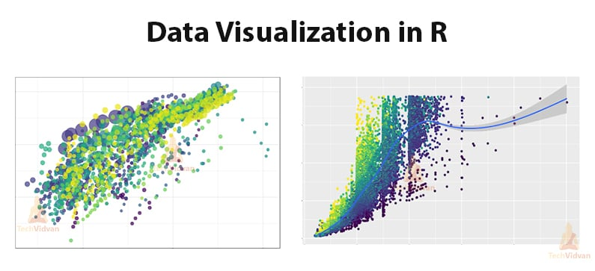
Some Unique Features of R Programming
Due to a large number of packages available, there are many other handy features as well:
Since R can perform operations directly on vectors, it doesn’t require too much looping.
R can pull data from APIs, servers, SPSS files, and many other formats.
R is useful for web scraping.
It can perform multiple complex mathematical operations with a single command.
Using R Markdown, it can create attractive reports that combine plain text with code and visualizations of the results.
Due to a large number of researchers and statisticians using it, new ideas and technologies often appear in the R community first.

Slide 8
Functions I used in this program!!
Key R Functions and Libraries:*1. *ggplot2:* - ggplot(): Creates a new ggplot object. - geom_col(): Creates a bar plot. - scale_x_continuous(): Sets the scale for the x-axis. - coord_flip(): Flips the x and y axes. - labs(): Sets labels for the plot. - scale_fill_manual(): Sets the color palette for the plot.2. *Base R Functions:* - readline(): Reads input from the user. - as.numeric(): Converts character strings to numeric values. - strsplit(): Splits a string into a list of substrings. - data.frame(): Creates a data frame. - rep(): Repeats elements of a vector. - plot(): Creates a basic plot. - seq(): Generates a sequence of numbers. - log(), exp(): Mathematical functions for logarithmic and exponential calculations. - if, else if, else: Conditional statements. - while: Looping construct. - print(): Prints output to the console.*Key Concepts and Techniques:*- *Data Input and Manipulation:* Reading user input, converting data types, and creating data frames.- *Data Visualization:* Creating various types of plots (bar plots, line plots) using ggplot2.- *Statistical Analysis:* Calculating population growth rates, population density, and other relevant metrics.- *Conditional Logic:* Using if-else statements to make decisions based on user input and data analysis results.- *Looping:* Using while loops to repeatedly execute code blocks.

Slide 9
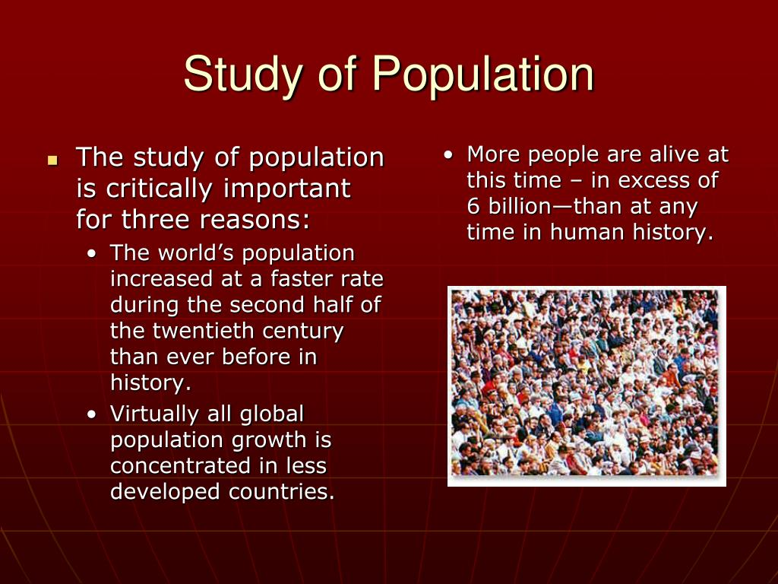
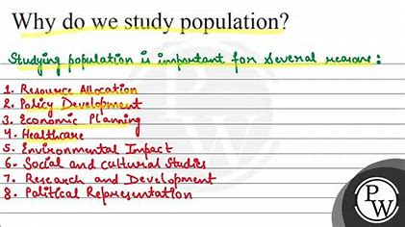
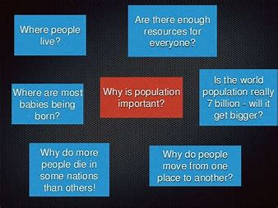
Why does population study matter?
Arranging data makes see similarities making it easy to store n retrieve data
Predicting future trends
Finding errors in management to find where to target correction
Population shows types of people around
Population study tells us about diseases(epidemiology)

Slide 10
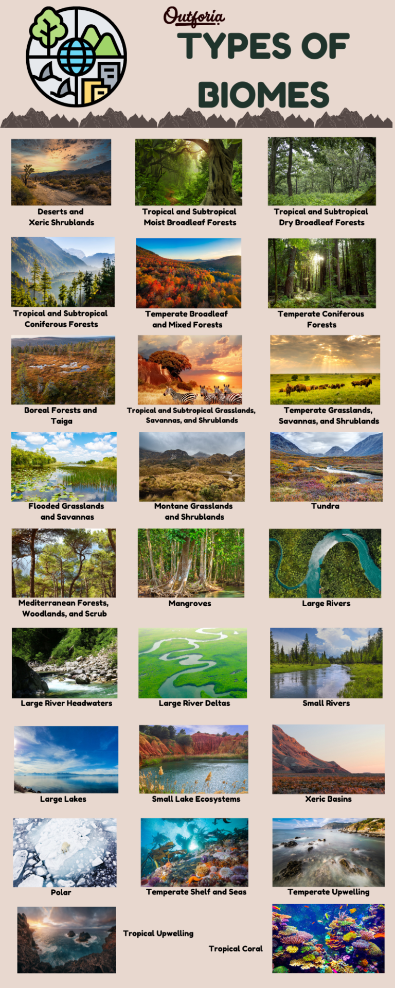
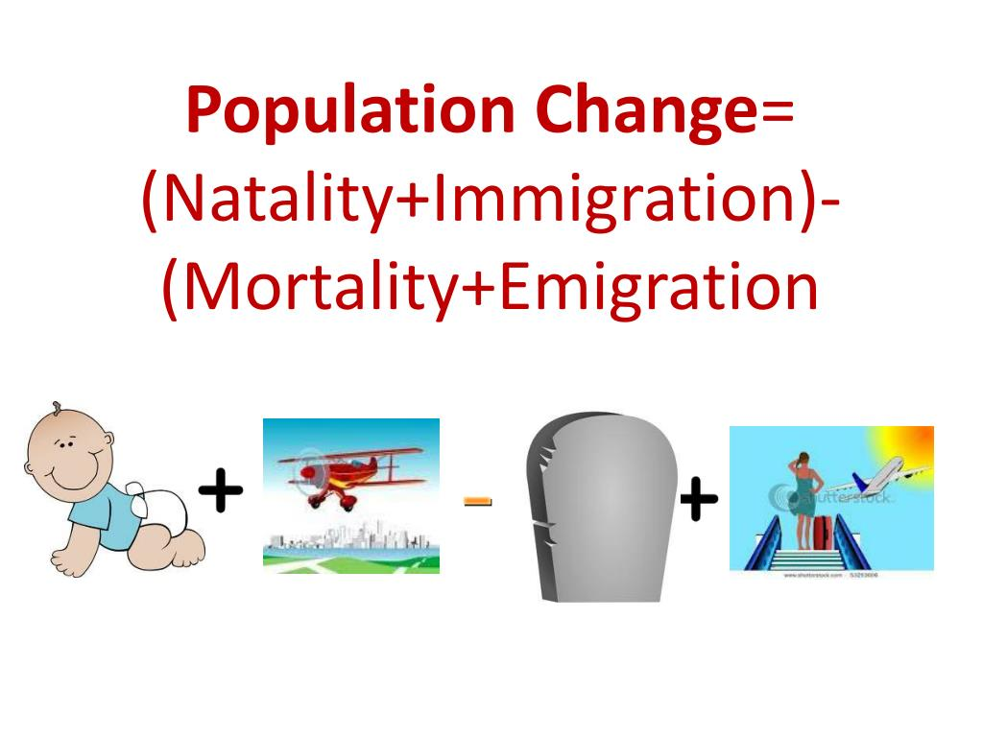
Population metrics (numerical attribute)
Natality-birth per year showing fertility rate
Fatality-people dying every year showing health stats and life expectancy
Immigration-coming from other place shows demand of place where they go
Emmigration-going away from a place
Density-population per area

Slide 11

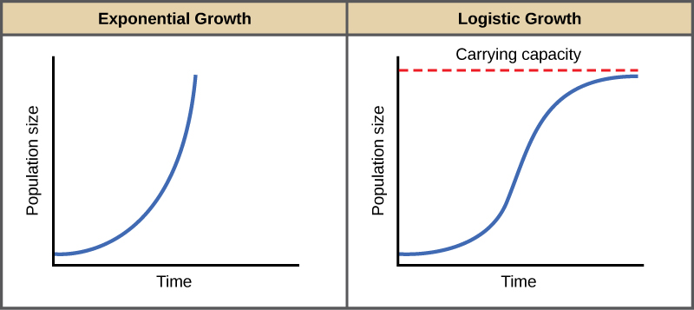

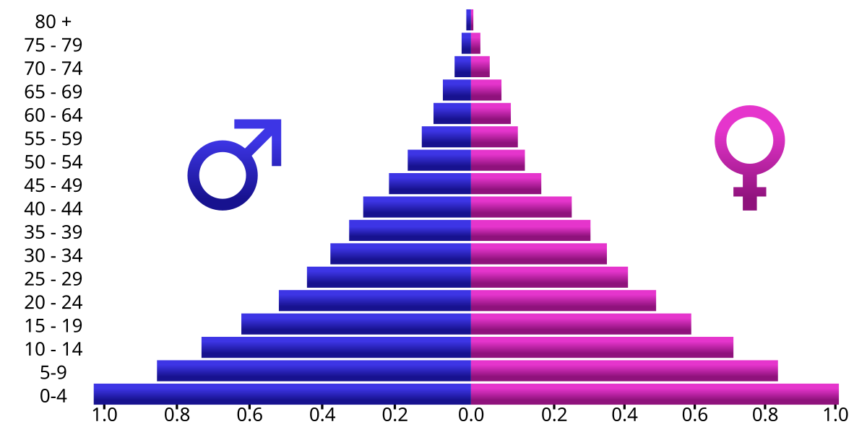
Population Composition (structural attribute)
Age composition-children,working,aged
Gender ratio-female per 1000 males
Literacy rate-knowing reading n writing in atleast one language
Occupational-primary(producers),secondary(manufacturers),tertiary(service),quaternary(professional)
Health-amount of medical cases per year
adolescent_-10-19yr kids
This Photo by Unknown Author is licensed under CC BY
This Photo by Unknown Author is licensed under CC BY-SA

Slide 12



How I stumbled on this idea
Canada,Italy,korea are doing their daily need work on their own due to labour shortage like delivering own packages,which was contrary to my thought that population is a liability
R was a new language which I wanted to explore as its extensively used in bioinformatics after python,so,I thought a project means to showcase creativity,So, lets give my new interest life in this project

Slide 13





Factors affecting population
Climate/light from latitude or longitude-optimal temperature or energy waste to metabolism
Fertility of the soil-vegetation and food
Air composition of area-air is essential for metabolism of both plants and animals
Water availability-water used for drinking,manufacturing(indus valley,venice),travel,coolant,dispersal.farming,cleaning &drainage
Landforms-plains have right amount of gases,soil thickness,wind speed
Wildlife-keeps population in check through food chain & makes urea for plants
Mineral deposits-these are very important commercial resources
Religion and cultural factors-some cultural peaceful & secure places attract tourists(delhi-Noida)
forests-attract rain,bind soil,purify air,gives herb,wood,paper,food,lac,gum,rubber,honey,recreation
By manipulating these factors we can regulate population

Slide 14
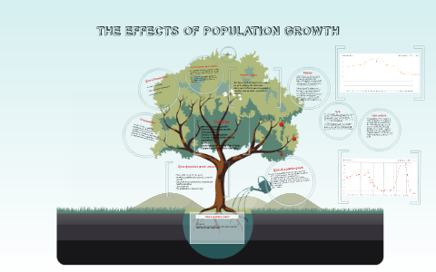
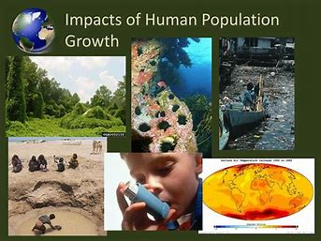
Does population affect anything?
Population makes pollution but can be reduced by composting 3rs,compost,landfill &incineration
Population reduces space
Population takes up resources leading to poverty
Proper utilization of resources makes population an asset as humans are stock of knowledge and productive skill which contribute in national income and inspire others,even any asset without human intervention cant reach full potential & human make resource useful
Unemployment is a biggest setback in this-15-59 yrs old not working or working not visible on record(disguised) or seasonal(working but not always)
While some natural resource can be used repeatedly(renewable) but sustainable planning is need

Slide 15
Code
library(ggplot2)# Logistic growth modellogistic_growth <- function(r, K, N0, t) { N <- K / (1 + (K / N0 - 1) * exp(-r * t)) return(N)}# Function to get region-specific dataget_region_data <- function() { region_name <- readline("Enter region name: ") population <- as.numeric(readline("Enter population: ")) area <- as.numeric(readline("Enter area: ")) return(data.frame(Region = region_name, Population = population, Area = area))}# Age pyramid functioncreate_age_pyramid <- function(){ # Get user input age_groups_str <- readline("Enter age groups separated by commas: ") male_pop_str <- readline("Enter male population for each age group separated by commas: ") female_pop_str <- readline("Enter female population for each age group separated by commas: ") male_literacy_str <- readline("Enter male literacy rate for each age group separated by commas: ") female_literacy_str <- readline("Enter female literacy rate for each age group separated by commas: ") # Convert input strings to numeric vectors age_groups <- suppressWarnings(as.numeric(strsplit(age_groups_str, ",")[[1]])) male_pop <- suppressWarnings(as.numeric(strsplit(male_pop_str, ",")[[1]])) female_pop <- suppressWarnings(as.numeric(strsplit(female_pop_str, ",")[[1]])) male_literacy <- suppressWarnings(as.numeric(strsplit(male_literacy_str, ",")[[1]])) female_literacy <- suppressWarnings(as.numeric(strsplit(female_literacy_str, ",")[[1]])) # Create a long-formatted data frame for plotting data <- data.frame( Age_Group = rep(age_groups, 2), Gender = rep(c("Male", "Female"), each = length(age_groups)), Population = c(-male_pop, female_pop), Literacy = c(male_literacy, female_literacy) ) # Create the age pyramid plot ggplot(data, aes(x = Age_Group, y = Population, fill = Gender, group = Gender)) + geom_col(position = "identity") + scale_x_continuous(breaks = age_groups) + coord_flip() + labs(title = "Age Pyramid", x = "Age Group", y = "Population") + scale_fill_manual(values = c("Male" = "blue", "Female" = "pink")) if (max(female_pop) > max(male_pop)) { print("Shape: Urn-shaped (top-heavy)") print("Population Status: Decreasing") print("you may go extinct good for your competitors but not for your gene but you have many reserve natural resources and good breathing space") } else if (max(female_pop) < max(male_pop)) { print("Shape: Bell-shaped (expanding)") print("Population Status: Increasing") print("you have plenty of human resource but shelter space maybe reduced with increasing poverty and pollution ") } else { print("Shape: Columnar (stable)") print("A balanced population! Keep up the good work in maintaining this equilibrium.") print("Population Status: Increasing") # Further analysis is needed for overpopulation/underpopulation # Visualize literacy rates ggplot(data, aes(x = Age_Group, y = Literacy, color = Gender, group = Gender)) + geom_line() + geom_point() + labs(title = "Literacy Rate by Age and Gender", x = "Age Group", y = "Literacy Rate (%)")}}# Main function to handle user input and calculationsmain_function<- function() { while (TRUE) { user_choice <- readline("Enter 'logistic', 'agepyramid', 'density', or 'stop': ") if (user_choice == "logistic") { # Initial population size and time check N0_initial <- as.numeric(readline("Enter the initial population size (N0): ")) time_elapsed <- as.numeric(readline("Enter the time elapsed (in years): ")) if (is.finite(time_elapsed)==TRUE)

Slide 16
Code part-2
{ # Calculate final population, growth rate, and carrying capacity deaths <- as.numeric(readline("Enter the total number of deaths: ")) births <- as.numeric(readline("Enter the total number of births: ")) N_final <- N0_initial + births - deaths r <- (log(N_final / N0_initial)) / time_elapsed K <- N_final * exp(r * time_elapsed) # Generate time series and population data time <- seq(0, time_elapsed, by = 0.1) # Adjust the time step as needed population <- logistic_growth(r, K, N0_initial, time) # Plot logistic population growth plot(time, population, type = "l", xlab = "Time (years)", ylab = "Population Size", main = "Logistic Population Growth") } else { print("Invalid time") } } else if (user_choice == "agepyramid") { create_age_pyramid() } else if (user_choice == "density") { # Get region data from user num_regions <- as.numeric(readline("Enter the number of regions: ")) region_data <- data.frame() for (i in 1:num_regions) { region_data <- rbind(region_data, get_region_data()) } # Calculate population density region_data$Density <- region_data$Population / region_data$Area # Plot population density distribution ggplot(region_data, aes(x = Region, y = Density, fill = Region)) + geom_bar(stat = "identity") + labs(title = "Population Density Distribution by Region", x = "Region", y = "Population Density") + theme(axis.text.x = element_text(angle = 45, hjust = 1)) # Suggest actions based on population density distribution if (sd(region_data$Density) > threshold) { # Adjust threshold as needed print("Consider policies to address regional disparities in population density.") } else { print("Population density distribution appears relatively balanced.") } } else if (user_choice == "stop") { break } else { print("Invalid choice. Please enter 'logistic', 'agepyramid', 'density', or 'stop'.") } } print("Do you have any questions or suggestions? (yes/no)") user_input <- readline() if (tolower(user_input) == "yes") { question <- readline("What's your question or suggestion?") print("Thanks for your ques/suggestion! I'll try to improve response.") }}main_function()# Get the initial population statuspopulation_status <- readline("Enter population status (increasing/decreasing): ")# Conditional logic based on population statusif (population_status == "decreasing") { # User wants to sustain, increase, or spread the population desired_action <- readline("Do you want to sustain, increase, or spread your population? ") # Conditional logic based on the desired action if (desired_action == "sustain") { # User chooses good or evil mode for sustainability mode <- readline("Do you want to go good or evil mode? ") # Implement good or evil mode actions here (placeholders for now) if (mode == "good") { print("improve health,hygiene,working conditions and safety measures,common laws,maintain gender ratio n literacy rate,allocate barren lands for industries & good land for dense habitation") } else { print("favour your people by resrvation,free shelter,allow polygamy,women & children work from home,increase automation to let humans grow in other aspects") print("promote investment to young and reduce their burden by paying old people,promote more child by govt schemes,make artificial water n food source,deform landforms for construction to reduce altitude to make favourable environment,deforest safe from wild and gain heat energy") } } else if (desired_action == "increase") { # User chooses good or evil mode for increasing population mode <- readline("Do you want to go good or evil mode? ") # Implement good or evil mode actions here (placeholders for now) if (mode == "good") { print("promote organic nutritious food for good health and fertility not only survival,socialise people n promote easy online contact,reduce job competition,give dignity n maternity leave to women,make open-minded to accept all") } else { print("glorify love,reduce consequence of live-in relationship & marriage age,use anime to fantasize & induce repr*ductive maturity in k*ds to grow good in fertile age of teens") } } else { # User chooses good or evil mode for spreading population mode <- readline("Do you want to go good or evil mode? ") # Implement good or evil mode actions here (placeholders for now) if (mode == "good") { print("market your culture,invest in infrastucture for tourists,promote business to attract best talents,promote citizenship by marriage(spread m add gene n values)") } else { print("allow immigration by forced conversion,compulsory education n compulsory teaching self defense") } }} else { # User wants to utilize, reduce, or sustain the population desired_action <- readline("Do you want to utilize, reduce, or sustain your population? ") # Conditional logic based on the desired action if (desired_action == "sustain") { # User chooses good or evil mode for sustainability mode <- readline("Do you want to go good or evil mode? ") # Implement good or evil mode actions here (placeholders for now) if (mode == "good") { print("grow wheat as can grow anywhere,anytemp,can be made hyv & pest resistant crop easily with good calories for survival,save resources using 3R's") print("use eco_friendly disposal of waste like composting,introduce forest & wildlife to keep population in check n replenish natural resources,promote sci-fi shows and books to encourage hustle") } else { print("conquer lands,feed GMO's,teach reproduction science to know its real cause & not exploit it,reduce pension to reduce govt costs,limit no. of child,reduce purifying water,make others selfish & individualistic,increase arms but not defense") } } else if (desired_action == "utilize") { # User chooses good or evil mode for utilizing population mode <- readline("Do you want to go good or evil mode? ") # Implement good or evil mode actions here (placeholders for now) if (mode == "good") { print("export human resources(job) for good ties,their resources and forex reserves,ggod division of labour for right talent") } else { print("run science or data experiments,introduce slavery,make immigration difficult,enhance artificial bionic humans") } } else { # User chooses good or evil mode for reducing population mode <- readline("Do you want to go good or evil mode? ") # Implement good or evil mode actions here (placeholders for now) if (mode == "good") { print("use c*ntraceptives,invest more in education(scholarships)than healthcare,stricter & extend marriage age & boundations(genes),choose best by increasing competition,glorify being single (free life)") print("c**doms may not be the best but are safest with privacy and no permanent toll on health") print("pills can induce hormonal problems while iut's arent private while vasectomy is irreversible,to be considered") } else { print("engage in a w*r as civilians only get hurt in this,start a gen*c*de,spread a pandem*c,tolerate civil v*olence,heavy workload(mental issues),promote risky jobs,no hygiene or safety,support illegal emmigration") } }}

Slide 17
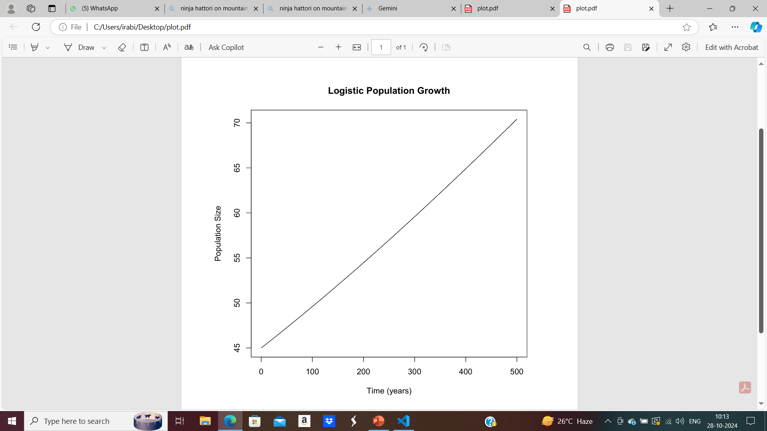
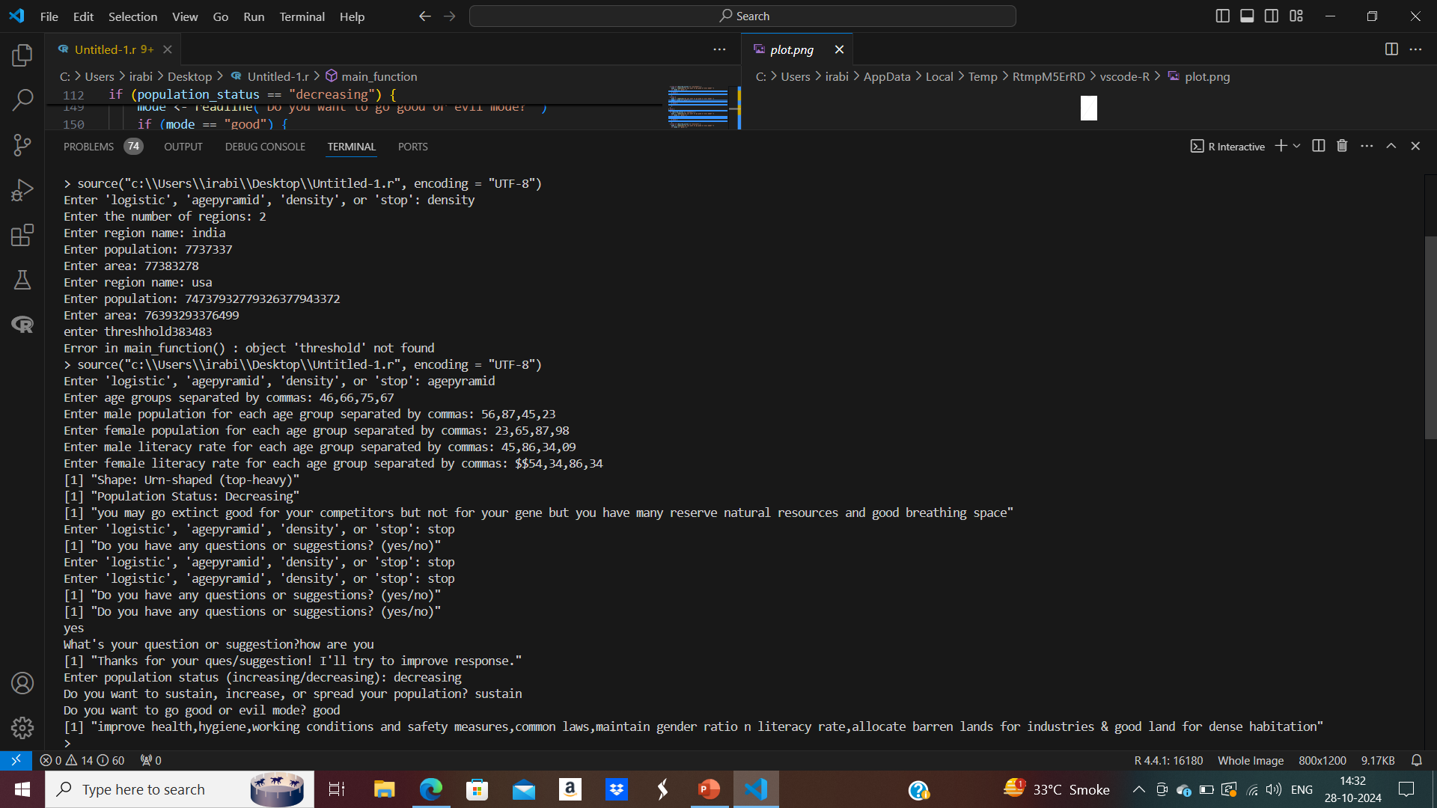
Output

Slide 18
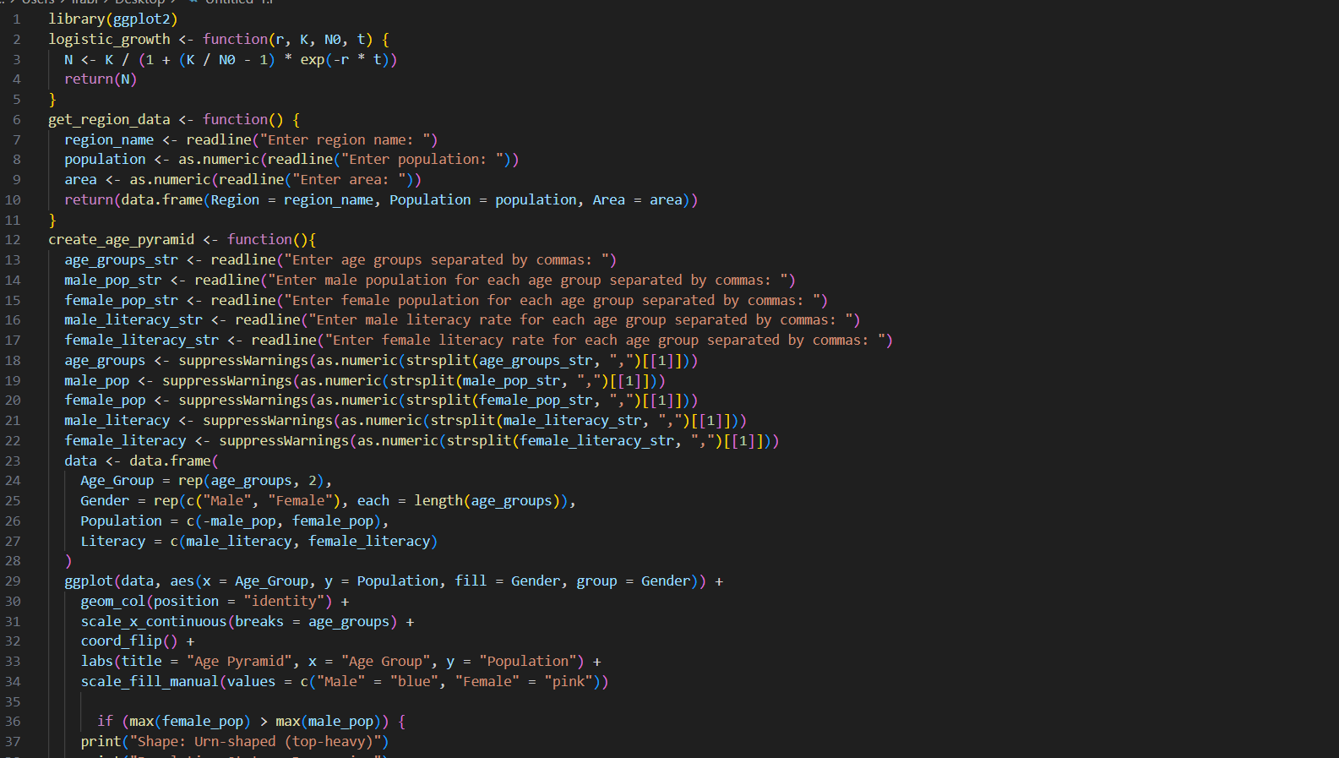

Slide 19
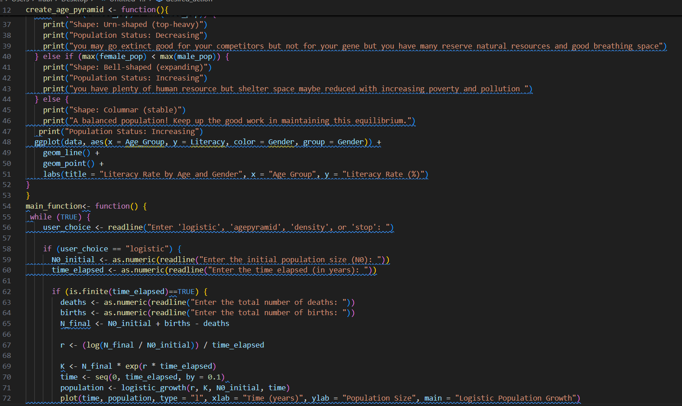

Slide 20
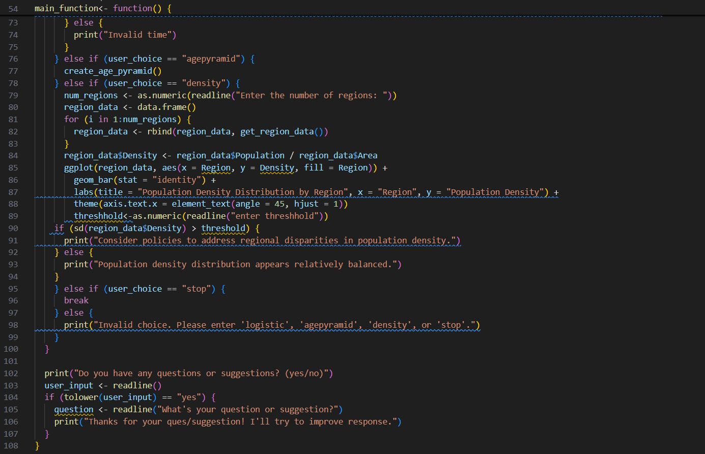

Slide 21
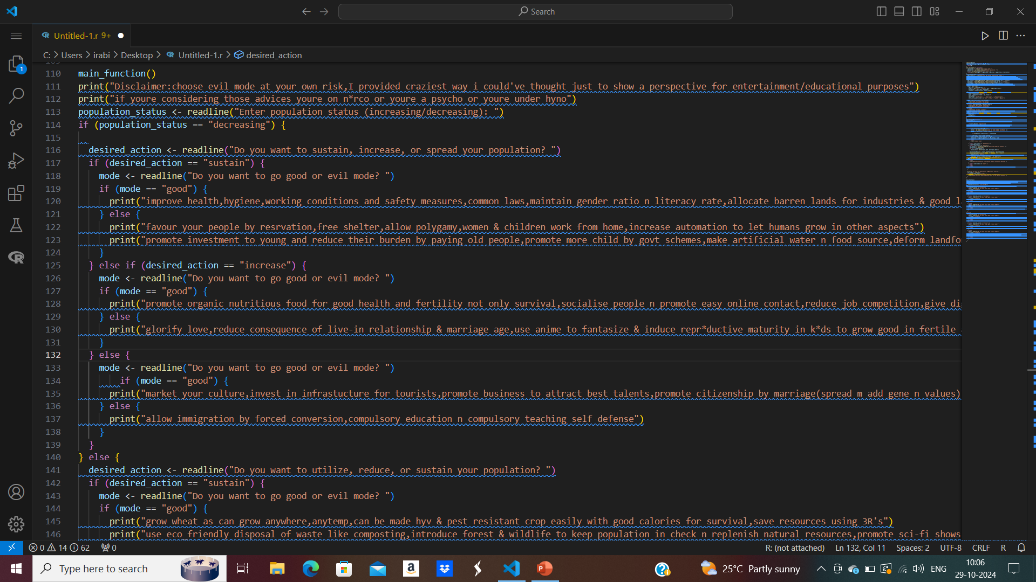
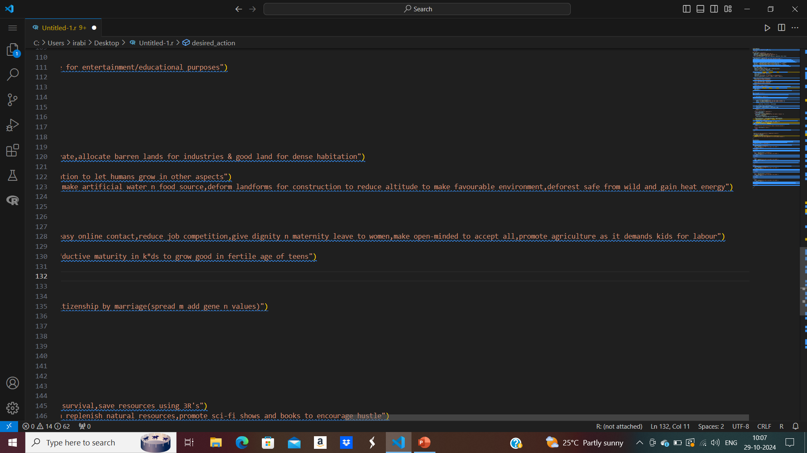
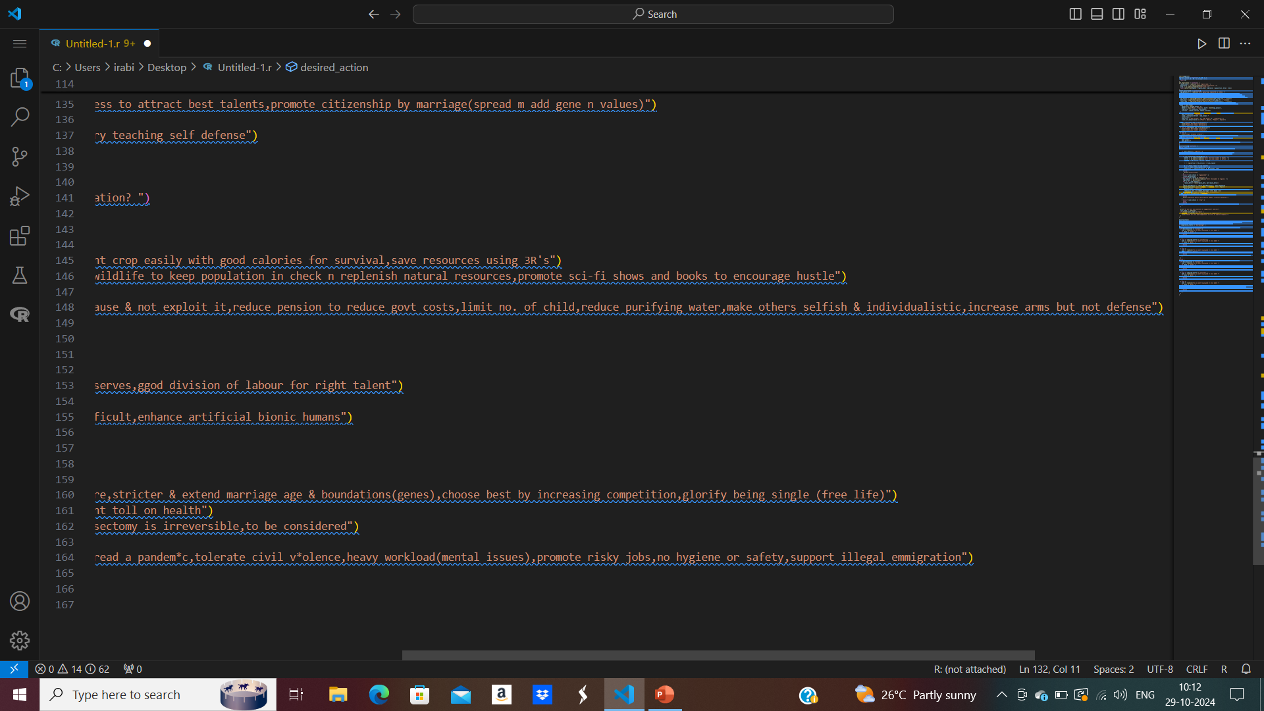


Slide 22
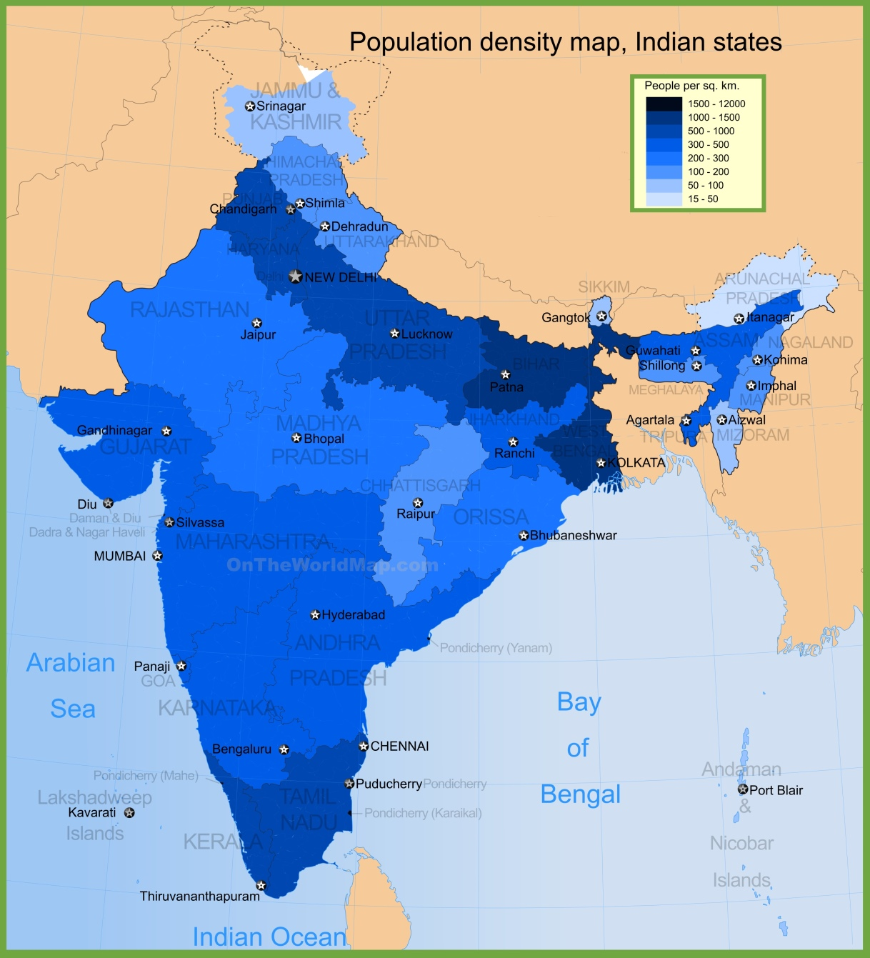
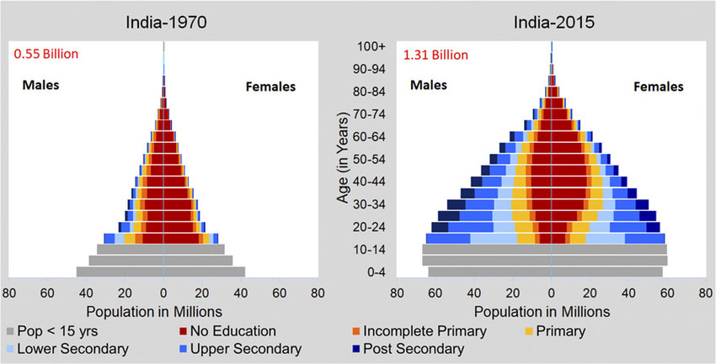
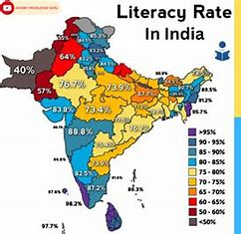


Indian population stats

Slide 23
Thank You!!
- Arabinda chand
This Photo by Unknown Author is licensed under CC BY-SA-NC

